Slide 1
FP4470 viscosity
Juliane Junesch, AEE TCS
Henkel Düsseldorf, Germany
2021-09-17

Slide 2
FP4470
background
3DPlus noticed viscosity changes over time when it is heated (50C).
Therefore they would like to have viscosity curve at 50°C for 2 hours and an other curve at 25°C.

Slide 3
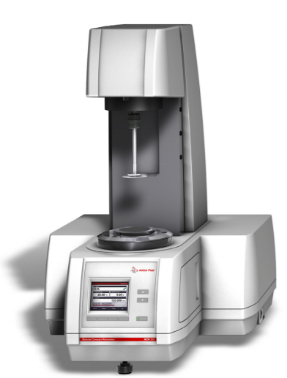
Equipment & Settings
Rheometer
The viscosity was measured with Anton Paar Rheometer MCR302 H-PTD200
Settings were copied from IFX
Parallel Plate 25mm
Gap 0.2mm Temperature: 25°C, 50°C
Hold 10 min without shear force
Shear rates: 1s⁻¹
Time 2 hours

Slide 4
FP4470
Viscosity over time

Slide 5
Conclusion
The viscosity of FP4410 was tracked over 2hours at 25°C and 50°C
It stayed stable over this time
@25°C is remained at 25.0 Pas
@50°C there is a slight increase (from 2.8Pas to 3.1 Pas)

Slide 6
THANK YOU

